Slide 1
Key Findings Briefing October 2024 N=514 Likely Voters Statewide
N=

Slide 2
Sample Profile
AFFILIATION
GENDER
AGE

Slide 3
Sample Profile
AFFILIATION
GENDER
AGE

Slide 4
Vote History
Swing Voters are respondents that self identified as historically voting for candidates across party lines. Swing voters comprise 25% (N=129) of the sample.
SWING VOTERS
BY AFFILIATION

Slide 5
STATE ECONOMY AND WAY OF LIFE

Slide 6
Quality of Life
Quality of life in Connecticut remains high with strong majority of voters (66%) describing it as either good (50%) or excellent (16%). This has remained relatively consistent over the past four years.
How would you rate your overall quality of life in Connecticut? Would you say it is excellent, good, fair or poor?

Slide 7
Future Outlook
Segments that were more likely to say it will hold less opportunity include: Republicans (44%), Unaffiliated (40%) and Swing Voters (36%),
Do you think the future of Connecticut holds more opportunity for you and your family, less opportunity or that their will be no change?

Slide 8
Affordability
Overall, a majority of voters (59%) find it difficult to maintain their standard of living in Connecticut. – 20% Very Difficult / 37% SMWT Difficult. This is up +2% from March 2024 (57%).
70% of Swing Voters and 68% of Unaffiliated Voters feel that it is difficult to maintain their standard of living which is consistent with
Overall, how easy or difficult are you finding it to maintain your standard of living out of your total household income today?
Total Difficult: 59%
Total Easy: 38%

Slide 9
October 2020 to October 2024
Unaffiliated and Swing voters views of quality of life and future outlook improved or stayed or relatively stayed the same from four years ago, while respondents feelings towards affordability dropped with both Unaffiliated (-8%) and Swing Voters (-13%)
UNAFFILIATED
SWING VOTERS
% Excellent/Good
% Excellent/Good
% Very Easy / SMWT Easy
% Very Easy / SMWT Easy
% More Opportunity
% More Opportunity

Slide 10
Personal Financial Situation
Would you say that your personal financial situation is improving or getting worse?

Slide 11
Retirement: Connecticut
Less than one-third of respondents (31%) think they will be able to retire comfortably. This is down 6 points from March 2024.
Do you think you will be able to retire comfortably?
Notes:
Mar 2024 YES | Fem 37% (-9) | Dem 45% (-9) | Unaff 35% (-7) | Swing 35% (-4)

Slide 12
STATE & NATIONAL POLITICS

Slide 13
Right Direction/Wrong Track
There was little change in direction of Connecticut from March 2024 but right direction dropped 5% from Oct 2023.
Generally speaking, do you think the country is headed in the right direction, or do you think things have gotten off on the wrong track?
Generally speaking, do you think the state of Connecticut is headed in the right direction, or do you think things have gotten off on the wrong track?
Notes:
Oct 2023 CT 48% Right Direction | 43% Wrong Track
Mar 2024 CT 45% Right Direction | 44% Wrong Track

Slide 14
Job Approval: Ned Lamont
Lamont’s overall approval did not change from Aug 2024.
50% of Unaffiliated Voters approve of his job performance, down -10% since October 2023 (Disapprove increased +5%).
His approval also fell with female voters from 66% to 59% (-7%) since October 2023.
DIS-APPROVE
APPROVE
NED LAMONT
NED LAMONT
APPROVE 58% | DISAPPROVE 37%
 | Str App | Smwt App | Smwt Dis | Str Dis | DK
AUG 2024 | 25% | 33% | 20% | 18% | 4%
OCT 2023 | 23% | 37% | 22% | 15% | 3%
UNAFF 2022 & 2023 60/37
14

Slide 15
Job Approval: Joe Biden
Overall, Biden’s approval improved (+4%) since October 2023.
This was driven largely by +8% change in approval among Democrat Voters. Males (+4%), Females (+4%), Swing (+3%), Unaffiliated (+2%).
DIS-APPROVE
APPROVE
BIDEN
APPROVE 46% | DISAPPROVE 51%
 | Str App | Smwt App | Smwt Dis | Str Dis | DK
AUG 2024 | 21% | 27% | 14% | 36% | 2%
OCT 2023 | 15% | 29% | 17% | 36% | 2%
Notes:
Approval dropped from 55% to 46% among female respondents. Male approval increased from 40% to 47%.

Slide 16
Trump vs Biden: Connecticut
Pluralities of Swing Voters (48%) and Unaffiliated Voters (43%) believe they were better off under President Trump with 20% and 22% saying they were Unsure, respectively.
Thinking about your own personal situation, do you believe you were better off under President Biden or former President Trump?
Notes:
Mar 2024 TRUMP – Fem 34% (+7) | Unaff 43% (+7) | Swing 48% (+11)

Slide 17
Election 2024: Presidential Ballot
Trump’s ballot share among all respondents improved by +10 from Oct 2020.
If the election for President was held today, and the candidates were Democrat Kamala Harris and Republican Donald Trump, who would you vote for?
Notes:
Oct 2020 Biden 57% | Trump 32% | Undecided 8%
Unaff Biden 47 | Trump 28 | Undecided 17%
Swing Biden 39 | Trump 33 | Undecided 20

Slide 18
Election 2024: Generic Ballot
If local elections for the state legislature were held today, would you vote for the Republican candidate or the Democrat candidate?
Notes:
2020 All Voters: Dem 46 | Rep 34 | Undecided 18
Unaffiliated: Dem 27 | Rep 35 | Undecided 34
Swing: Dem 15 | Rep 39 | Don’t know 41

Slide 19
Trump Effect: Down-Ballot
A majority of all voters (54%) say they are More Inclined to vote for Democrat Candidates with Trump on the ballot, up +2 from Aug 2024. Male Voters support for republicans’ down ballot fell from 46% in Aug 2024 to 39% and Swing Voters fell from 41% to 29% (-12 points).
With Donald Trump on the ballot, will you be more inclined to vote for Republican or Democrat candidates in other races?

Slide 20
ISSUES & PARTY TRUST

Slide 21
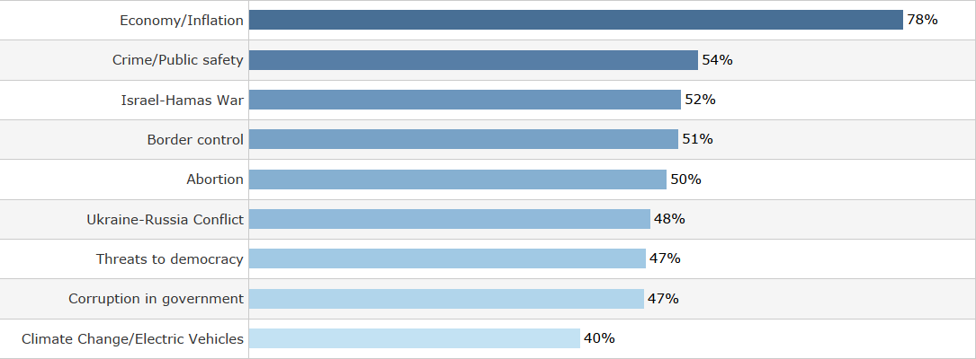
National Issues: Full Sample
What issues, NATIONALLY, have you been following? (Select all that apply)
Aug 2024 | Change
79% | -1%
57% | -3%
57% | -5%
61% | -10%
54% | -4%
63% | -15%
- | -
49% | -2%
48% | -8%

Slide 22
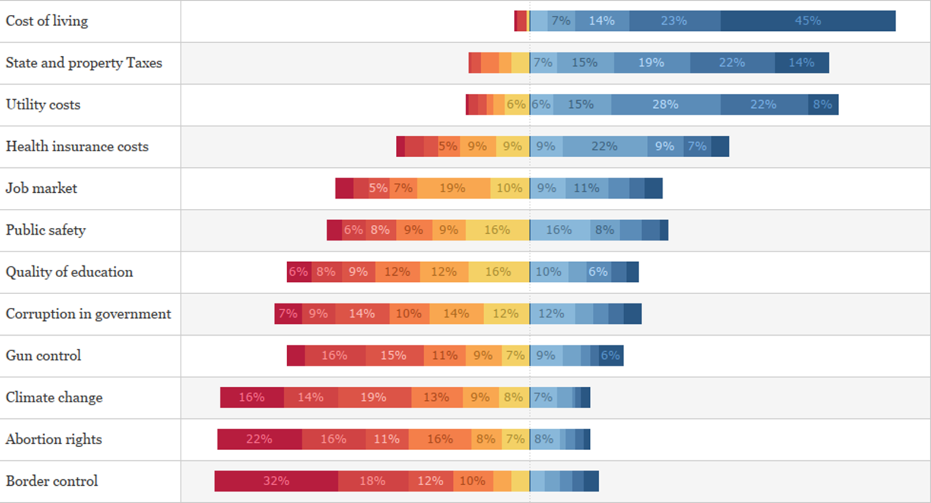
Issue Importance: Full Sample
Cost of Living remained the most important issue among all voters. Utility costs were ranked third most important issue. Climate Change, Abortion Rights and Border Control were ranked the least important issues.
When thinking about the issues impacting Connecticut, please rank the following from MOST IMPORTANT to LEAST IMPORTANT:
RANK | March 2024
1 | Cost of Living
2 | State and Property Taxes
3 | Health Insurance Costs
4 | Crime/Public Safety
5 | Job Market
6 | Quality of Education
7 | Gun Control
8 | Corruption in Gov’t
9 | Climate Change
10 | Abortion Rights
11 | Border Control

Slide 23
Issue Importance: Compared
Cost of Living remains the most important issued for all voter segments. There is almost universal agreement of the top five most important issues and they al deal with the cost of living. Only Republicans listed Public Safety in the top five issues.
When thinking about the issues impacting Connecticut, please rank the following from MOST IMPORTANT to LEAST IMPORTANT:
RANK | FEMALE | MALE | REPUBLICAN | DEMOCRAT | UNAFFILIATED | SWING
1 | Cost of Living (43%) | Cost of Living (38%) | Cost of Living (38%) | Cost of Living (35%) | Cost of Living (45%) | Cost of Living (45%)
2 | Utility Costs | State and Property Taxes | State and Property Taxes | State and Property Taxes | State and Property Taxes | State and Property Taxes
3 | State and Property Taxes | Utility Costs | Utility Costs | Utility Costs | Utility Costs | Utility Costs
4 | Health Insurance Costs | Health Insurance Costs | Health Insurance Costs | Health Insurance Costs | Health Insurance Costs | Health Insurance Costs
5 | Job Market | Job Market | Public Safety | Job Market | Job Market | Job Market
Notes:
Republicans: Border Control was 9/12

Slide 24
Party Trust on Issues: Full Sample
Unaffiliated voters trust Republicans over Democrats on the following issues: Border Control (63%), Economy and Inflation (62%), Crime and Public Safety (60%), and Israel-Hamas War (53%).
Swing voters trust Republicans over Democrats on the following issues: Border Control (71%), Economy and Inflation (70%), Crime and Public Safety (68%), and Israel-Hamas War (61%), Corruption in Government (55%), Ukraine-Russia Conflict (53%).
Which political party do you trust on the following issues?:
R+8
D+6
D+8
D+10
D+12
D+18
D+20
D+26
D+30

Slide 25
Party Trust on Issues: Unaffiliated and Swing
The following is a list of policy goals promoted by politicians in Connecticut. For each, please indicate which political party you think is most capable of actually achieving these outcomes.
 | UNAFFILIATED |  |  |  | SWING
 | DEM | REP | ADV |  | DEM | REP | ADV
Abortion | 66% | 34% | D+33 |  | 67% | 33% | D+35
Border control | 39% | 61% | R+22 |  | 33% | 67% | R+33
Climate Change/Electric Vehicles | 62% | 38% | D+25 |  | 60% | 40% | D+21
Corruption in government | 56% | 44% | D+13 |  | 54% | 46% | D+9
Crime/Public safety | 48% | 52% | R+4 |  | 40% | 60% | R+19
Defending democracy | 58% | 42% | D+16 |  | 52% | 48% | D+4
Economy/Inflation | 46% | 54% | R+8 |  | 38% | 62% | R+24
Israel-Hamas War | 47% | 53% | R+5 |  | 40% | 60% | R+21
Ukraine-Russia Conflict | 51% | 49% | D+2 |  | 46% | 54% | R+9

Slide 26
Crime: Connecticut
A strong majority of voters (64%) believe crime is a problem in Connecticut, this is unchanged from Aug 2024.
Do you believe crime is a problem in Connecticut?
Notes:
50-64: 49 worse / 20 improving

Slide 27
IMMIGRATION

Slide 28
Immigration: Issue Seriousness
78% of all voters think that Border Security is a Serious Issue – 47% Very Serious / 31% Somewhat Serious.. This is down 4 points from March 2024 (82%).
Half of Unaffiliated (50%) and Swing Voters (52% think Border Security is a Very Serious Issue.
How serious of an issue do you think BORDER SECURITY is for the country right now?
NOT SERIOUS
SERIOUS

Slide 29
Immigration: Undocumented Border Crossings
The number of voters that believe monthly border crossings by Undocumented Immigrants has increased during Biden’s presidency fell 6 points from March 2024 (72%)
A majority of Democrats 57% believe that monthly border crossings have decreased or stayed the same under Biden.
Do you think the number of monthly border crossings by UNDOCUMENTED immigrants has increased, decreased, or stayed the same since President Biden took office?

Slide 30
Immigration: Party Blame
Voters remain split on who’s to blame for the border crisis with 13% saying neither party is to blame.
48% of Republican Voters think that the Republican Party is to blame. This up 15 points since March 2024
Which party do you think has been the biggest impediment to resolving our border crisis?

Slide 31
UTILITY PRICES

Slide 32
Utility Prices: Electricity Costs
Nearly three-fourths of respondents have seen, read, or heard about increased electricity costs in Connecticut.
Have you seen, read, or heard anything about an increase in electricity costs in Connecticut?

Slide 33
Utility Prices: Electricity Costs
Democrats are more than twice as likely than Republican, Unaffiliated, and Swing voters to think that the government cares about the cost of electricity.
Do you think the government cares about the cost of electricity?

Slide 34
Utility Prices: Electricity Rate Increases
4 out 5 respondents have experienced a rate increase.
Have you personally experienced an increase in electricity rates in recent months?

Slide 35
Utility Prices: Electricity Rate Increases
4 out 5 respondents have experienced a rate increase.
Who do you blame most for the recent increase in electricity rates?

Slide 36
Utility Prices: Electricity Costs
Nearly three-fourths of respondents have seen, read, or heard about increased electricity costs in Connecticut.
Which political party do you feel is most capable of reducing the cost of electricity in Connecticut?

